Slide 1
C the Programming language
Functions and Pointers.
2nd Nov

Slide 2
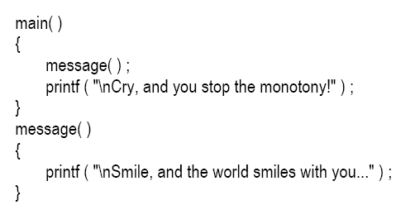
Function:
A function is a self-contained block of statements that perform a coherent task of some kind.

Slide 3
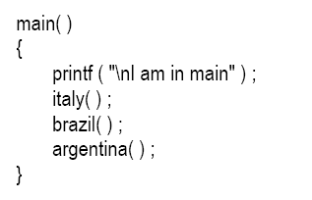
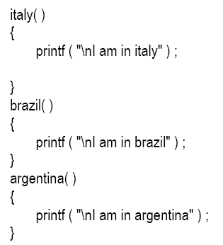
Call to more than one function:

Slide 4
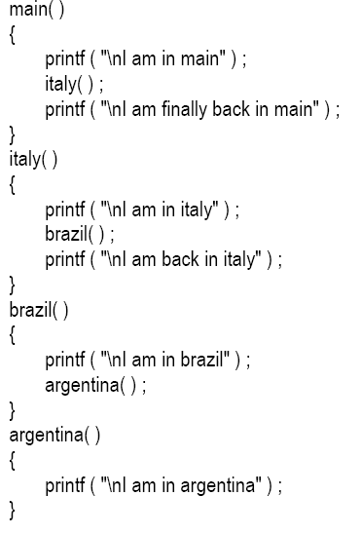

Slide 5
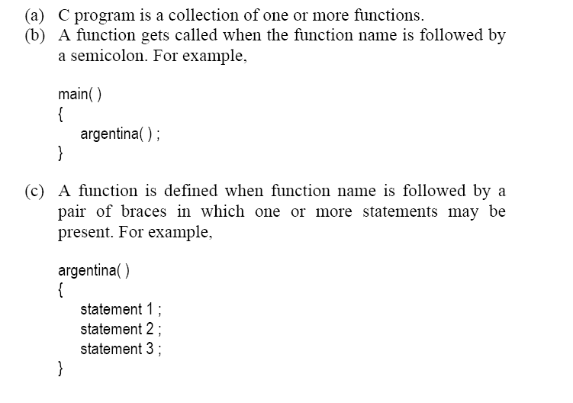

Slide 6
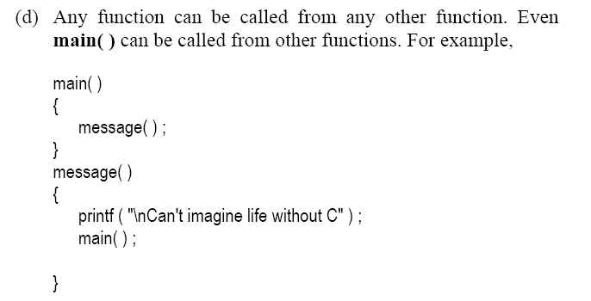

Slide 7
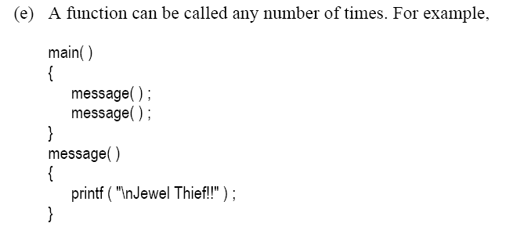

Slide 8
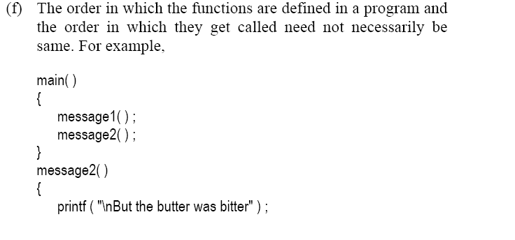
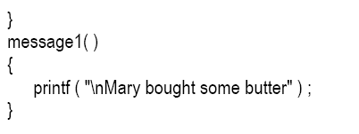

Slide 9
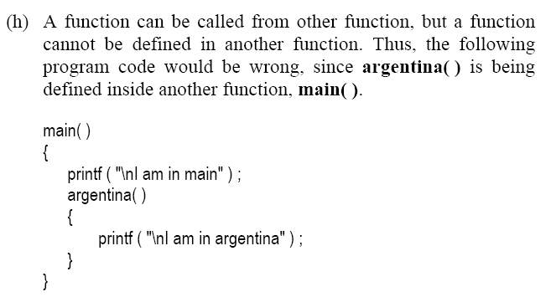

Slide 10
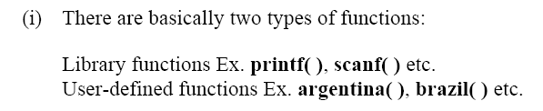

Slide 11
Why Use Function:
Writing functions avoids rewriting the same code over and over.
Using functions it becomes easier to write programs and keep track of what they are doing.

Slide 12
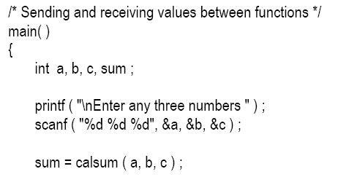
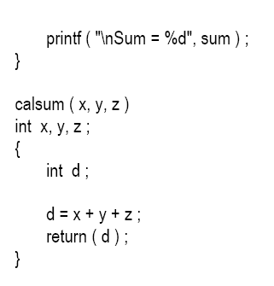
Passing Values between Functions

Slide 13
Return Statement
Return statement is used to return meaningful value to the calling functions.
The return statement serves two purposes:
On executing the return statement it immediately transfers the control back to the calling program.
It returns the value present in the parentheses after return, to the calling program.

Slide 14
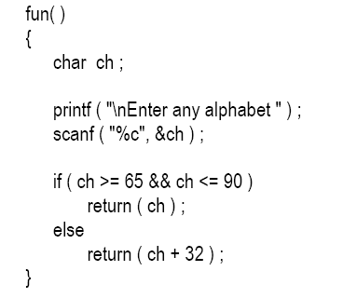
Multiple Return Statements:

Slide 15

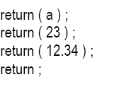

Whenever a meaningful value is returned as in our program it can be equated as:
Valid Return Statements:
Invalid Returns:

Slide 16
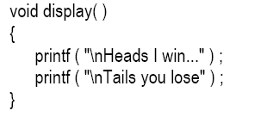
When function do not return any value:
If the value of a formal argument is changed in the called function, the corresponding change does not take place in the calling function.

Slide 17
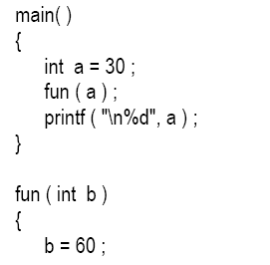


Slide 18
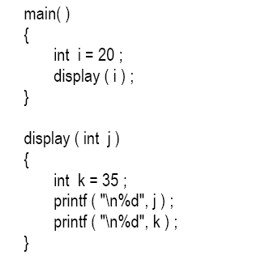
Scope Role of function:

Slide 19
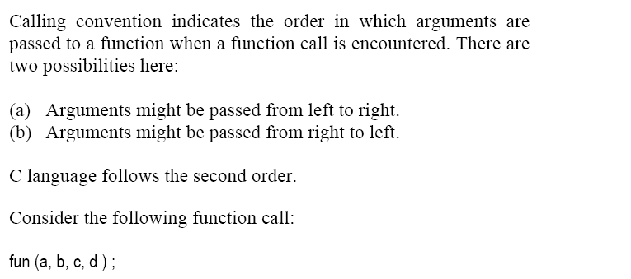

Calling Function:

Slide 20
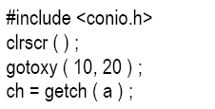
Dicey Issue:

Slide 21
Advanced Features of Functions:
Function Declaration and Prototypes
Calling functions by value or by reference
Recursion

Slide 22
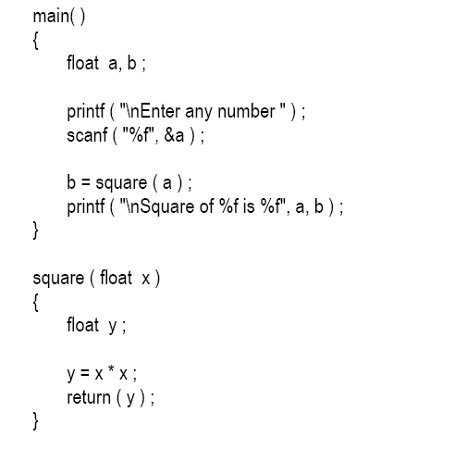
Function Declaration and Prototypes

Slide 23
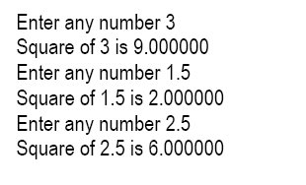
Output:

Slide 24
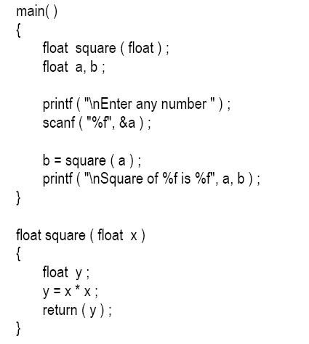

Slide 25
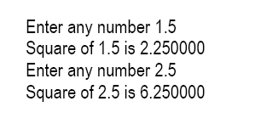
Output:

Slide 26
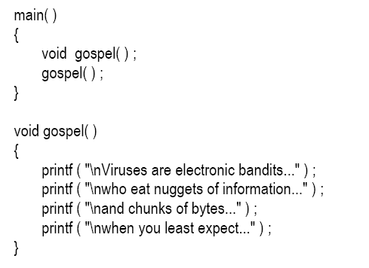
When Function do not returns any value:

